Slide 1
Forbes highest paying athletes analysis
Fernanda Valdez
Jason Cisneros
Uzor Francis

Slide 2
OUR INSPIRATION
The sports industry is valued in ~ US$ 500 BN worldwide and is growing 5.9% annually according to A.T. Kerney.
In 2018, sports sponsorships in N. America amounted to US$ 17 BN. This year, it is estimated to reach US$ 50 BN worldwide
The most valuable single sporting event in the world is valued in US$ 379 M. It’s the NFL Superbowl

Slide 3
RESEARCH QUESTIONS
Have top athlete earnings increased in real value over the past 30 years?
What sport pays it’s top athletes the most?
Are american athletes paid more than their foreign counterparts? Does this differ by sport?

Slide 4
DATA ENGINEERING

Slide 5
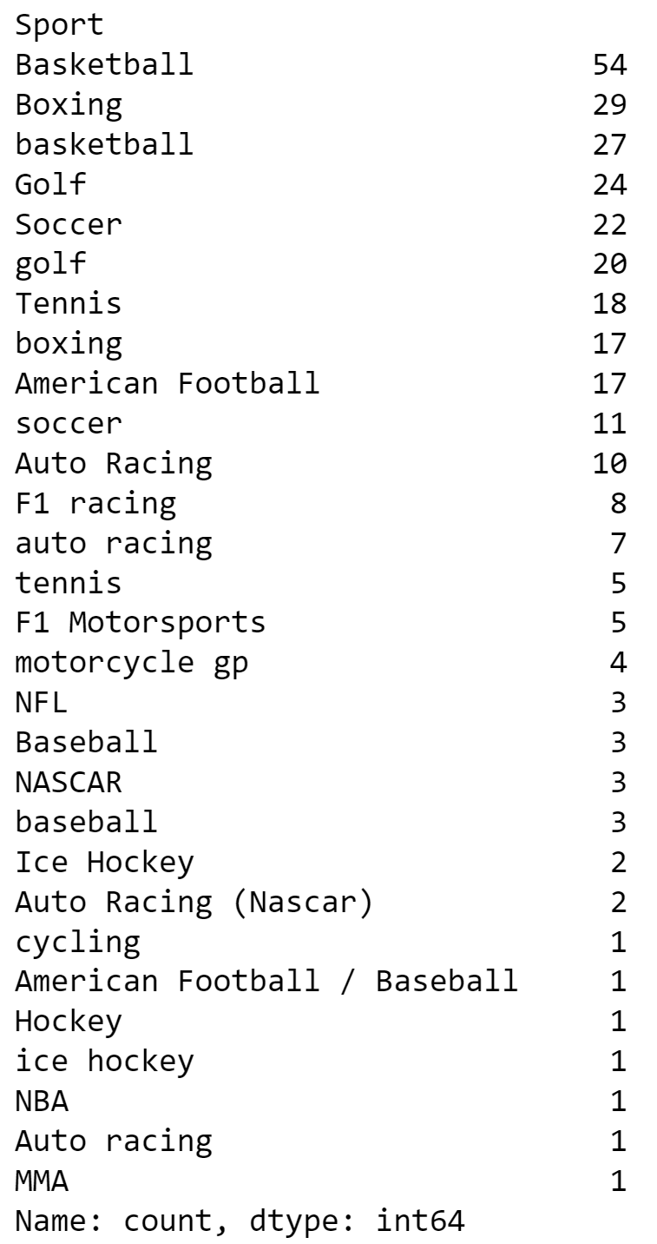
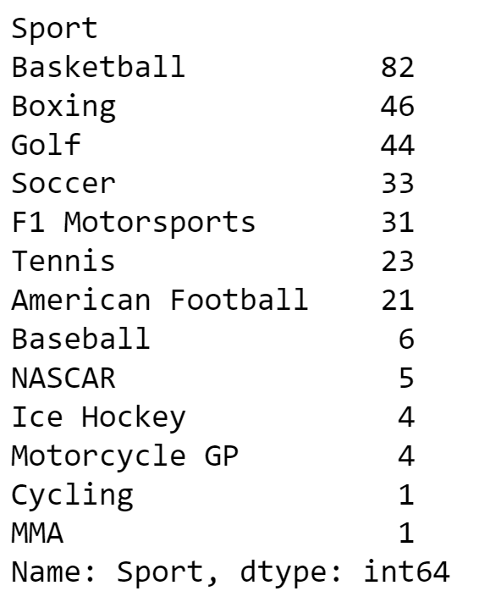
Data cleaning
Fixed structural errors:
Sports (From 29 to 13 categories)
Nationality (Fixed 1 entry)

Slide 6
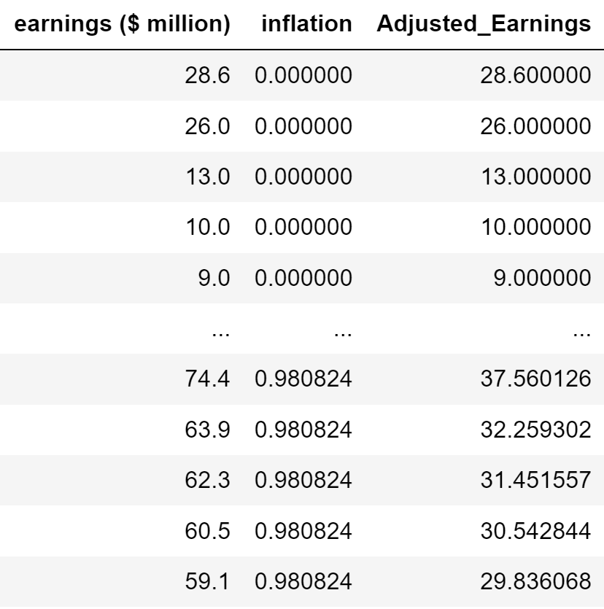
Adjusted earnings to 1990 US$
Imported an extra CSV file
Grouped CPI by year
Calculated mean CPI per year
Calculated inflation using CPI formula with 1990 as base year
Merged data with main DF by matching “Year” column
Divided nominal earnings by (1 + inflation) to adjust it to 1990 value

Slide 7
Are american athletes paid more than their foreign counterparts? Does this differ by sport?

Slide 8
hypothesis
American athletes earn more than their international counterparts

Slide 9
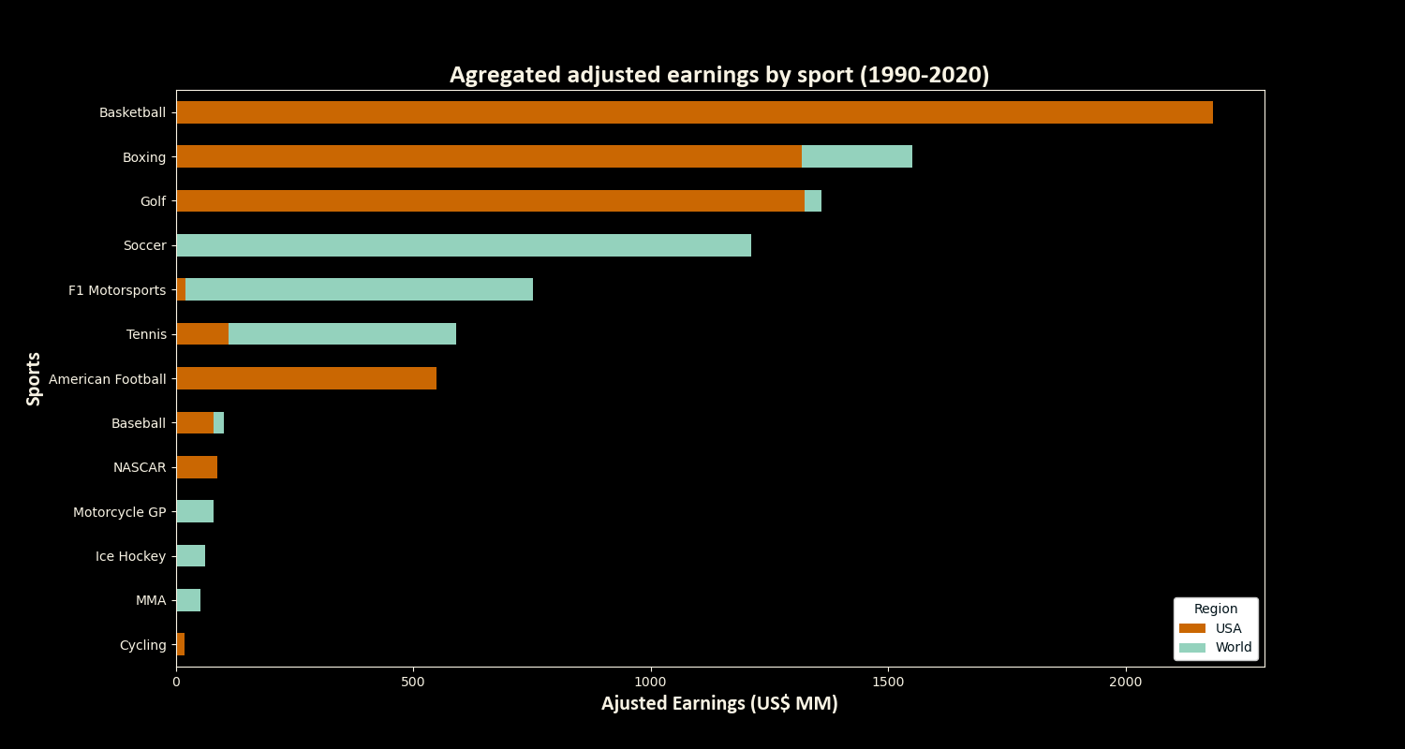
ÁREAS DE ENFOQUE
OPORTUNIDADES BASADAS EN LA NUBE
Desarrollar estrategias ganadoras para seguir a la vanguardia de la competencia
​Aprovechar los frutos obtenidos para identificar un valor en el terreno de juego
​Visualizar la convergencia dirigida al cliente
Enfoques iterativos para una estrategia corporativa
​Establecer un marco de administración desde dentro

Slide 10
Conclusions
66% of earnings (US$ 5,696 MM) go to USA athletes. Over US$ 2 MM of those earnings come from Basketball.
There is a clear difference in top paid athlete nationality depending on sports. Baketball, American Football, Golfing and Boxing are predominantly american while F1, Soccer and Tennis are predominantly international. This matches sports popularity as F1, Soccer and Tennis are sports that have historically had an international audience.
The American sport industry is the largest in the world, this appears to correlate with athlete salaries. We need more information to carry out a deeper análisis into salary drivers in the industry.

Slide 11
Have top athlete earnings increased in real value over the past 30 years?

Slide 12
hypothesis
Real earnings have increased over the past thirty years.

Slide 13
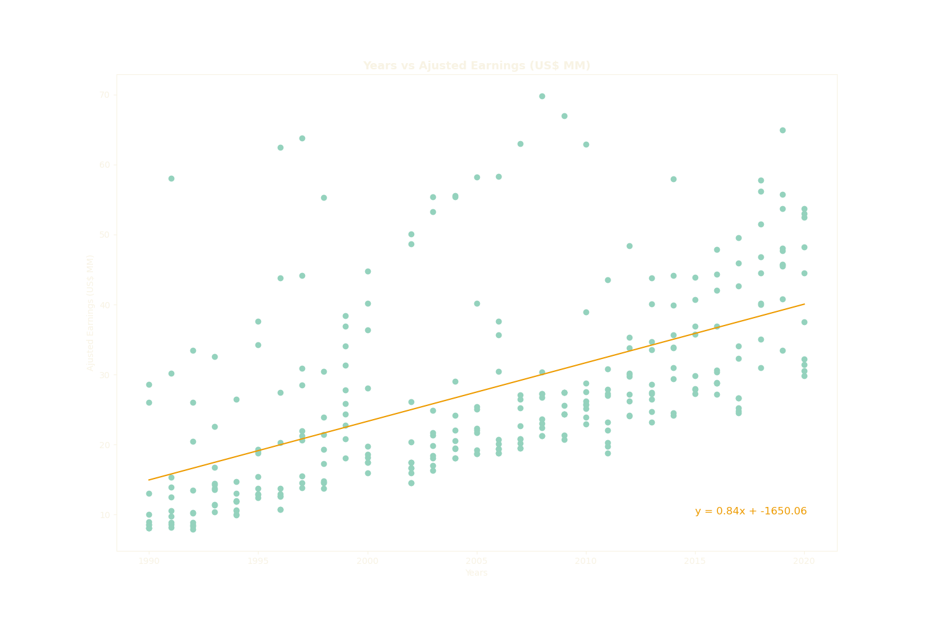
ÁREAS DE ENFOQUE
Desarrollar estrategias ganadoras para seguir a la vanguardia de la competencia
​Aprovechar los frutos obtenidos para identificar un valor en el terreno de juego
​Visualizar la convergencia dirigida al cliente
Enfoques iterativos para una estrategia corporativa
​Establecer un marco de administración desde dentro
R² = 0.31

Slide 14
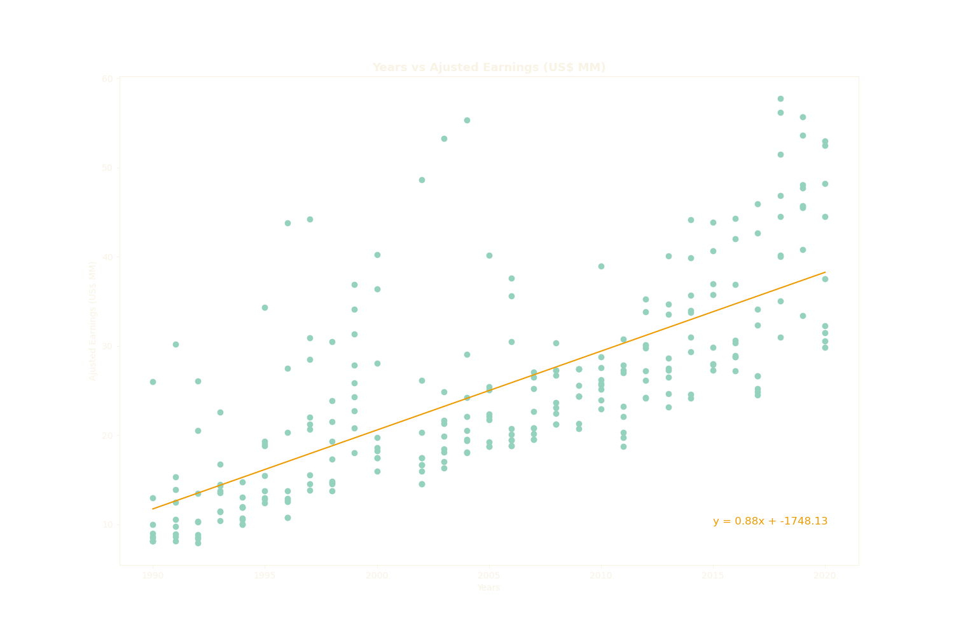
ÁREAS DE ENFOQUE
Desarrollar estrategias ganadoras para seguir a la vanguardia de la competencia
​Aprovechar los frutos obtenidos para identificar un valor en el terreno de juego
​Visualizar la convergencia dirigida al cliente
Enfoques iterativos para una estrategia corporativa
​Establecer un marco de administración desde dentro
R² = 0.52

Slide 15
Conclusions
There is a positive correlation between year and adjusted earnings, however only 31% of the variability is explained by the linear correlation model.
If we remove the top earner every year, the linear regression explains 52% of the variability.
Top earners positively skew the data

Slide 16
What sport pays its top athletes the most?

Slide 17
hypothesis
NBA and NFL players are the top earners.

Slide 18
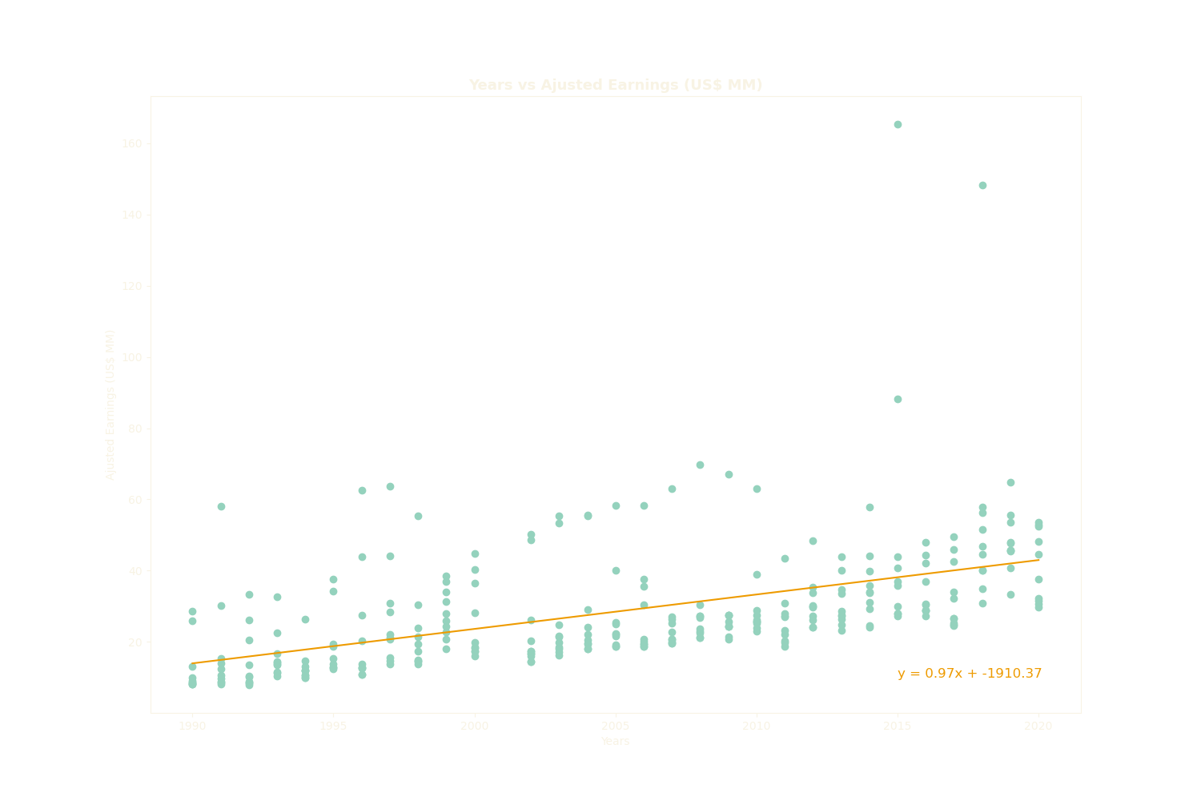
ÁREAS DE ENFOQUE
Desarrollar estrategias ganadoras para seguir a la vanguardia de la competencia
​Aprovechar los frutos obtenidos para identificar un valor en el terreno de juego
​Visualizar la convergencia dirigida al cliente
Enfoques iterativos para una estrategia corporativa
​Establecer un marco de administración desde dentro
R² = 0.25

Slide 19
ÁREAS DE ENFOQUE
Desarrollar estrategias ganadoras para seguir a la vanguardia de la competencia
​Aprovechar los frutos obtenidos para identificar un valor en el terreno de juego
​Visualizar la convergencia dirigida al cliente
Enfoques iterativos para una estrategia corporativa
​Establecer un marco de administración desde dentro

Slide 20
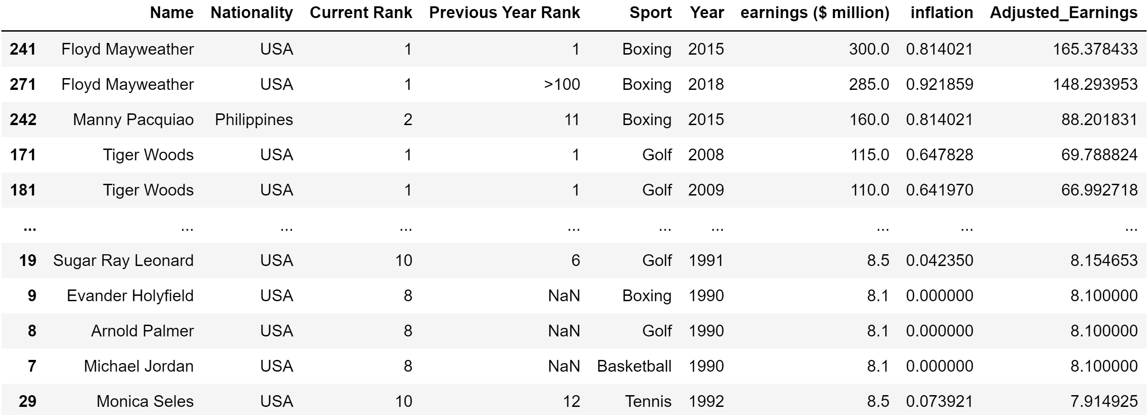
Top yearly earnings

Slide 21

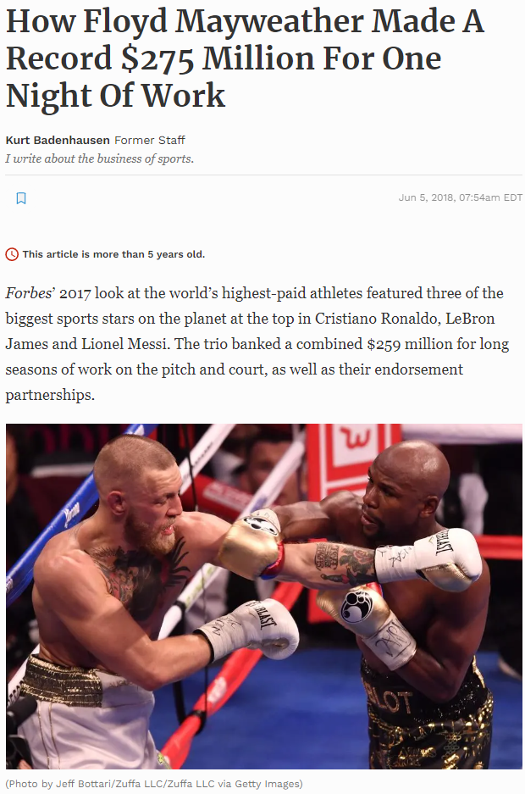
ÁREAS DE ENFOQUE
Desarrollar estrategias ganadoras para seguir a la vanguardia de la competencia
​Aprovechar los frutos obtenidos para identificar un valor en el terreno de juego
​Visualizar la convergencia dirigida al cliente
Enfoques iterativos para una estrategia corporativa
​Establecer un marco de administración desde dentro
Photo from Imdb
Image from Forbes

Slide 22
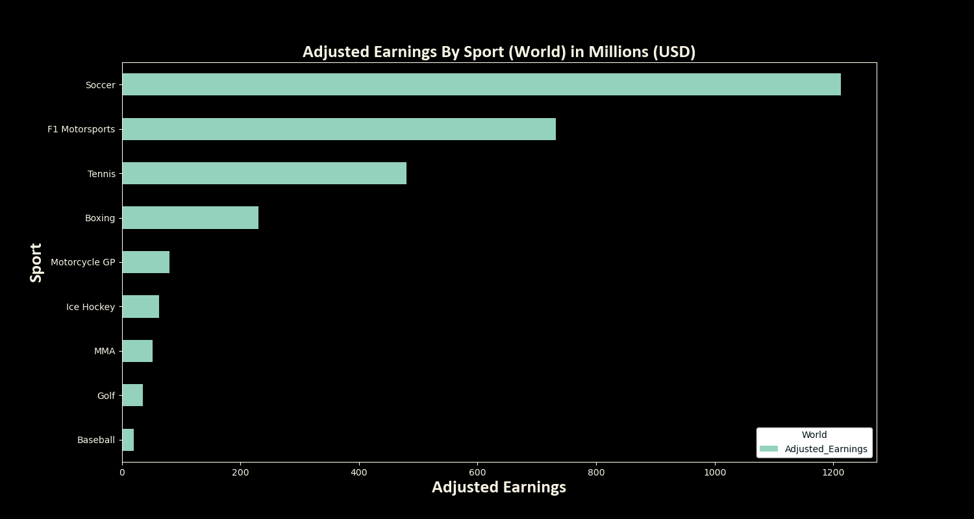
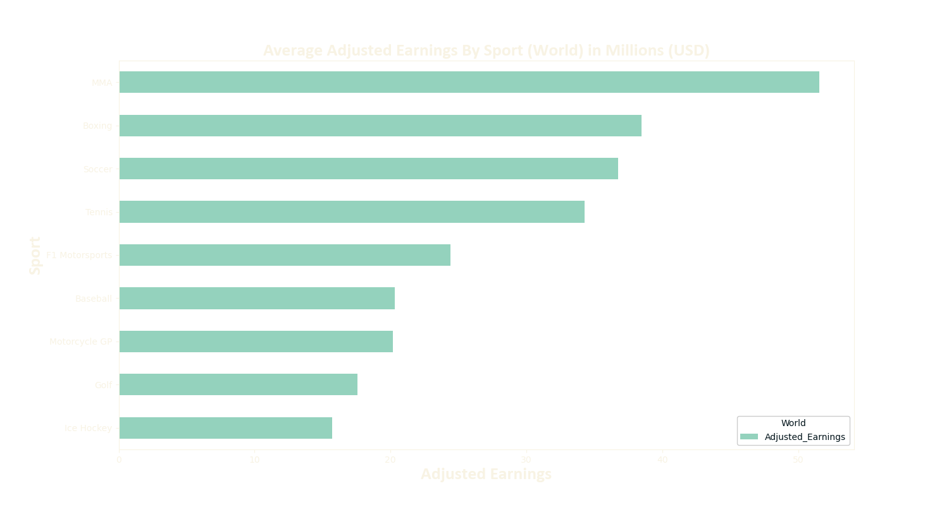
ÁREAS DE ENFOQUE
Desarrollar estrategias ganadoras para seguir a la vanguardia de la competencia
​Aprovechar los frutos obtenidos para identificar un valor en el terreno de juego
​Visualizar la convergencia dirigida al cliente
Enfoques iterativos para una estrategia corporativa
​Establecer un marco de administración desde dentro

Slide 23
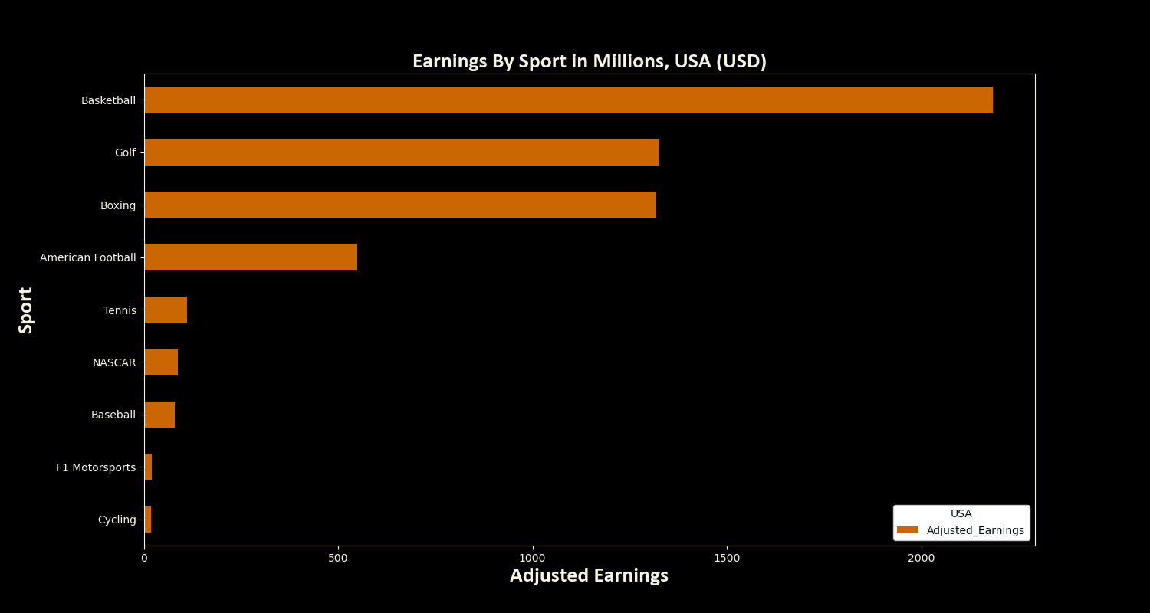
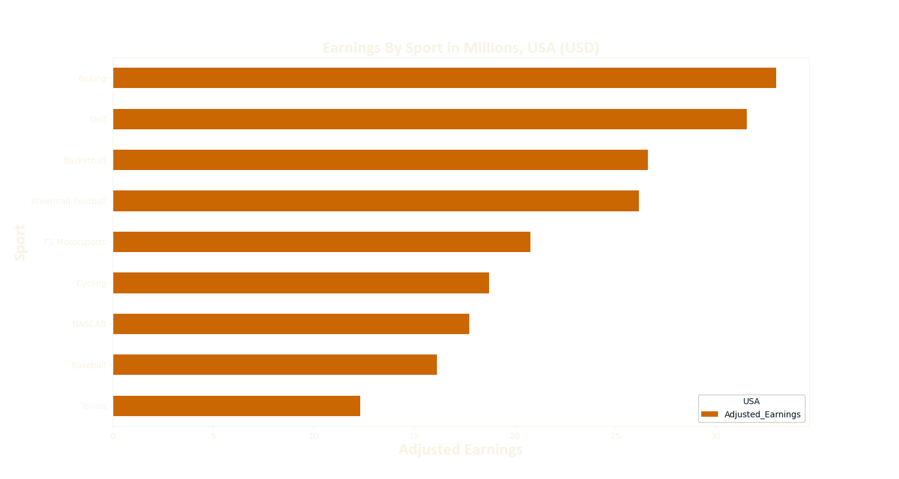
ÁREAS DE ENFOQUE
Desarrollar estrategias ganadoras para seguir a la vanguardia de la competencia
​Aprovechar los frutos obtenidos para identificar un valor en el terreno de juego
​Visualizar la convergencia dirigida al cliente
Enfoques iterativos para una estrategia corporativa
​Establecer un marco de administración desde dentro

Slide 24
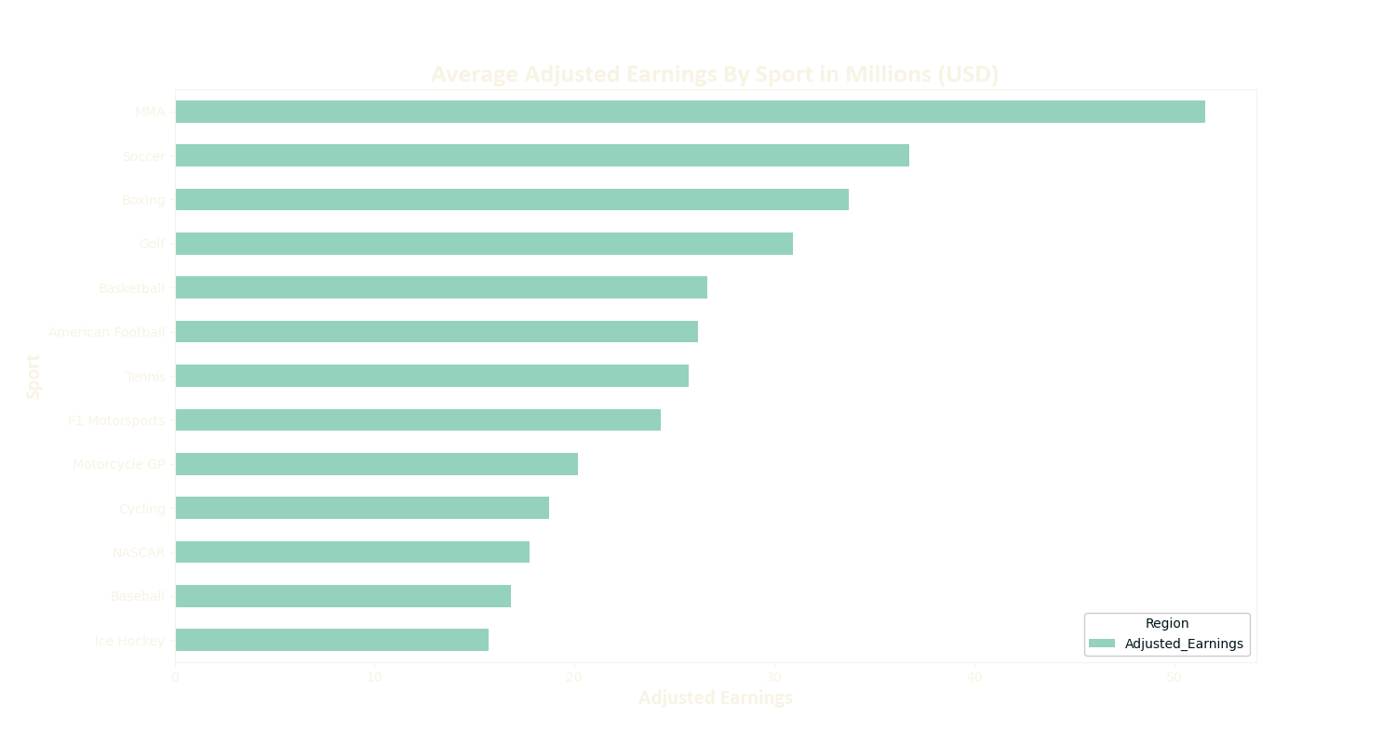
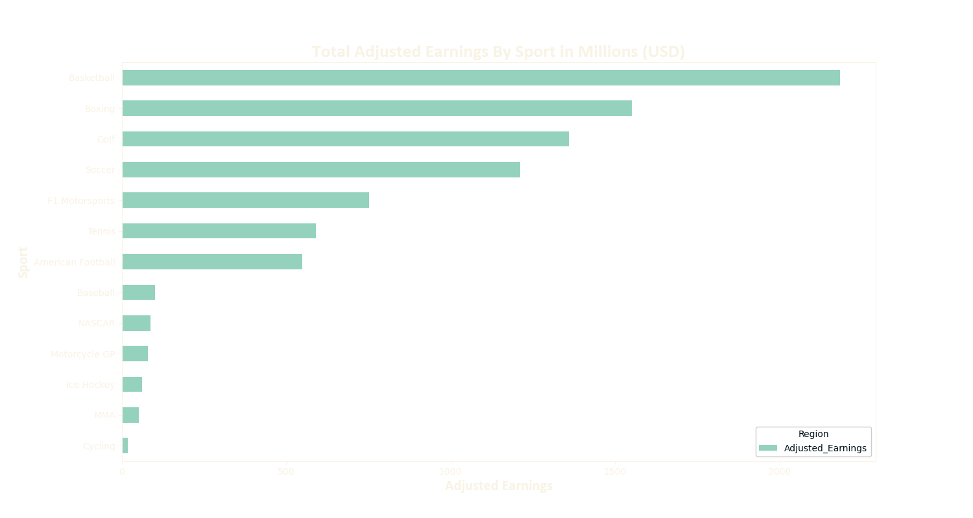
ÁREAS DE ENFOQUE
Enfoques iterativos para una estrategia corporativa
​Establecer un marco de administración desde dentro

Slide 25
Conclusions
Even tough aggregated earnings are the highest for Per capita earnings are higher in individual sports than they are in team sports.
Certain athletes earn well compared to others based on whether or not they are participating in a team sport or as an individual.
Boxing performs well overall due certain events that skew the overall pay information such as mega-fights.
There are sports that have an audience in the USA that aren’t available around the world and which would could potentially skew information.

Slide 26
Limitations and next steps

Slide 27
limitations
Database only included top earners for every year 10. It would be interesting to understand if regional data behaves similarly when analyzing a larger sample of athlete earnings.
We lacked industry data (ex. TV rights, number of spectators, team valuations) to carry out a correlation analysis to understand key drivers for earnings.
When it comes to calculating average earnings by country when it comes to athletes there is a limitation in the form of us not having a large enough sample size to illustrate this effectively

Slide 28
Thanks!

